Slide 1
OTP and Hash Functions
CSC4780 – COMPUTER Networks and Security
Instructor: Susmit Shannigrahi
sshannigrahi@tntech.edu

Slide 2
The Internet Is Public
Every message travels through networks you do not control.
Routers, ISPs, and servers process your data.
Yet you expect privacy when you log in or send a message.
How is private communication possible in a public system?
https://www.opte.org/the-internet

Slide 3
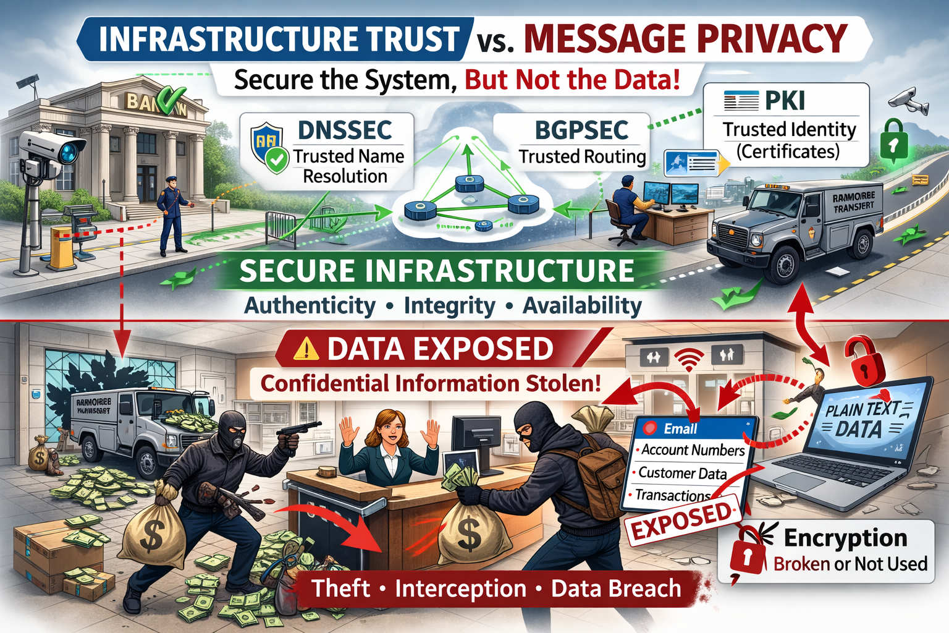
Infrastructure Trust vs Message Privacy
DNSSEC → correct destination.
BGPSEC → correct path.
PKI → correct identity.
Encryption → protects the message itself.

Slide 4
Security Foundations We Studied
DNSSEC protects domain name authenticity.
BGPSEC protects routing integrity.
PKI verifies digital identity.
Each solves a different trust problem.

Slide 5
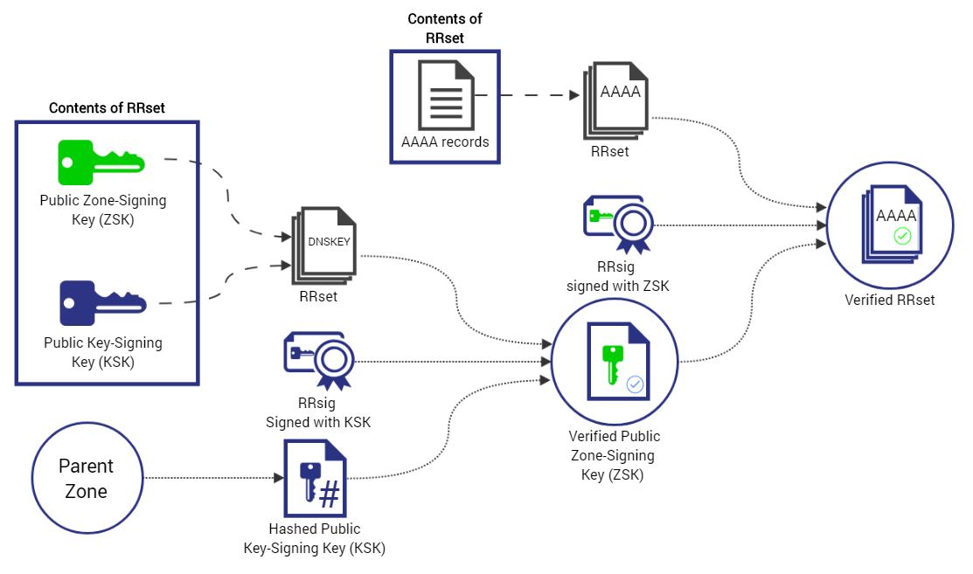
DNSSEC: Trusting the Name
Ensures DNS responses are authentic.
Prevents forged domain records.
Protects integrity, not confidentiality.
Builds trust in name resolution.

Slide 6
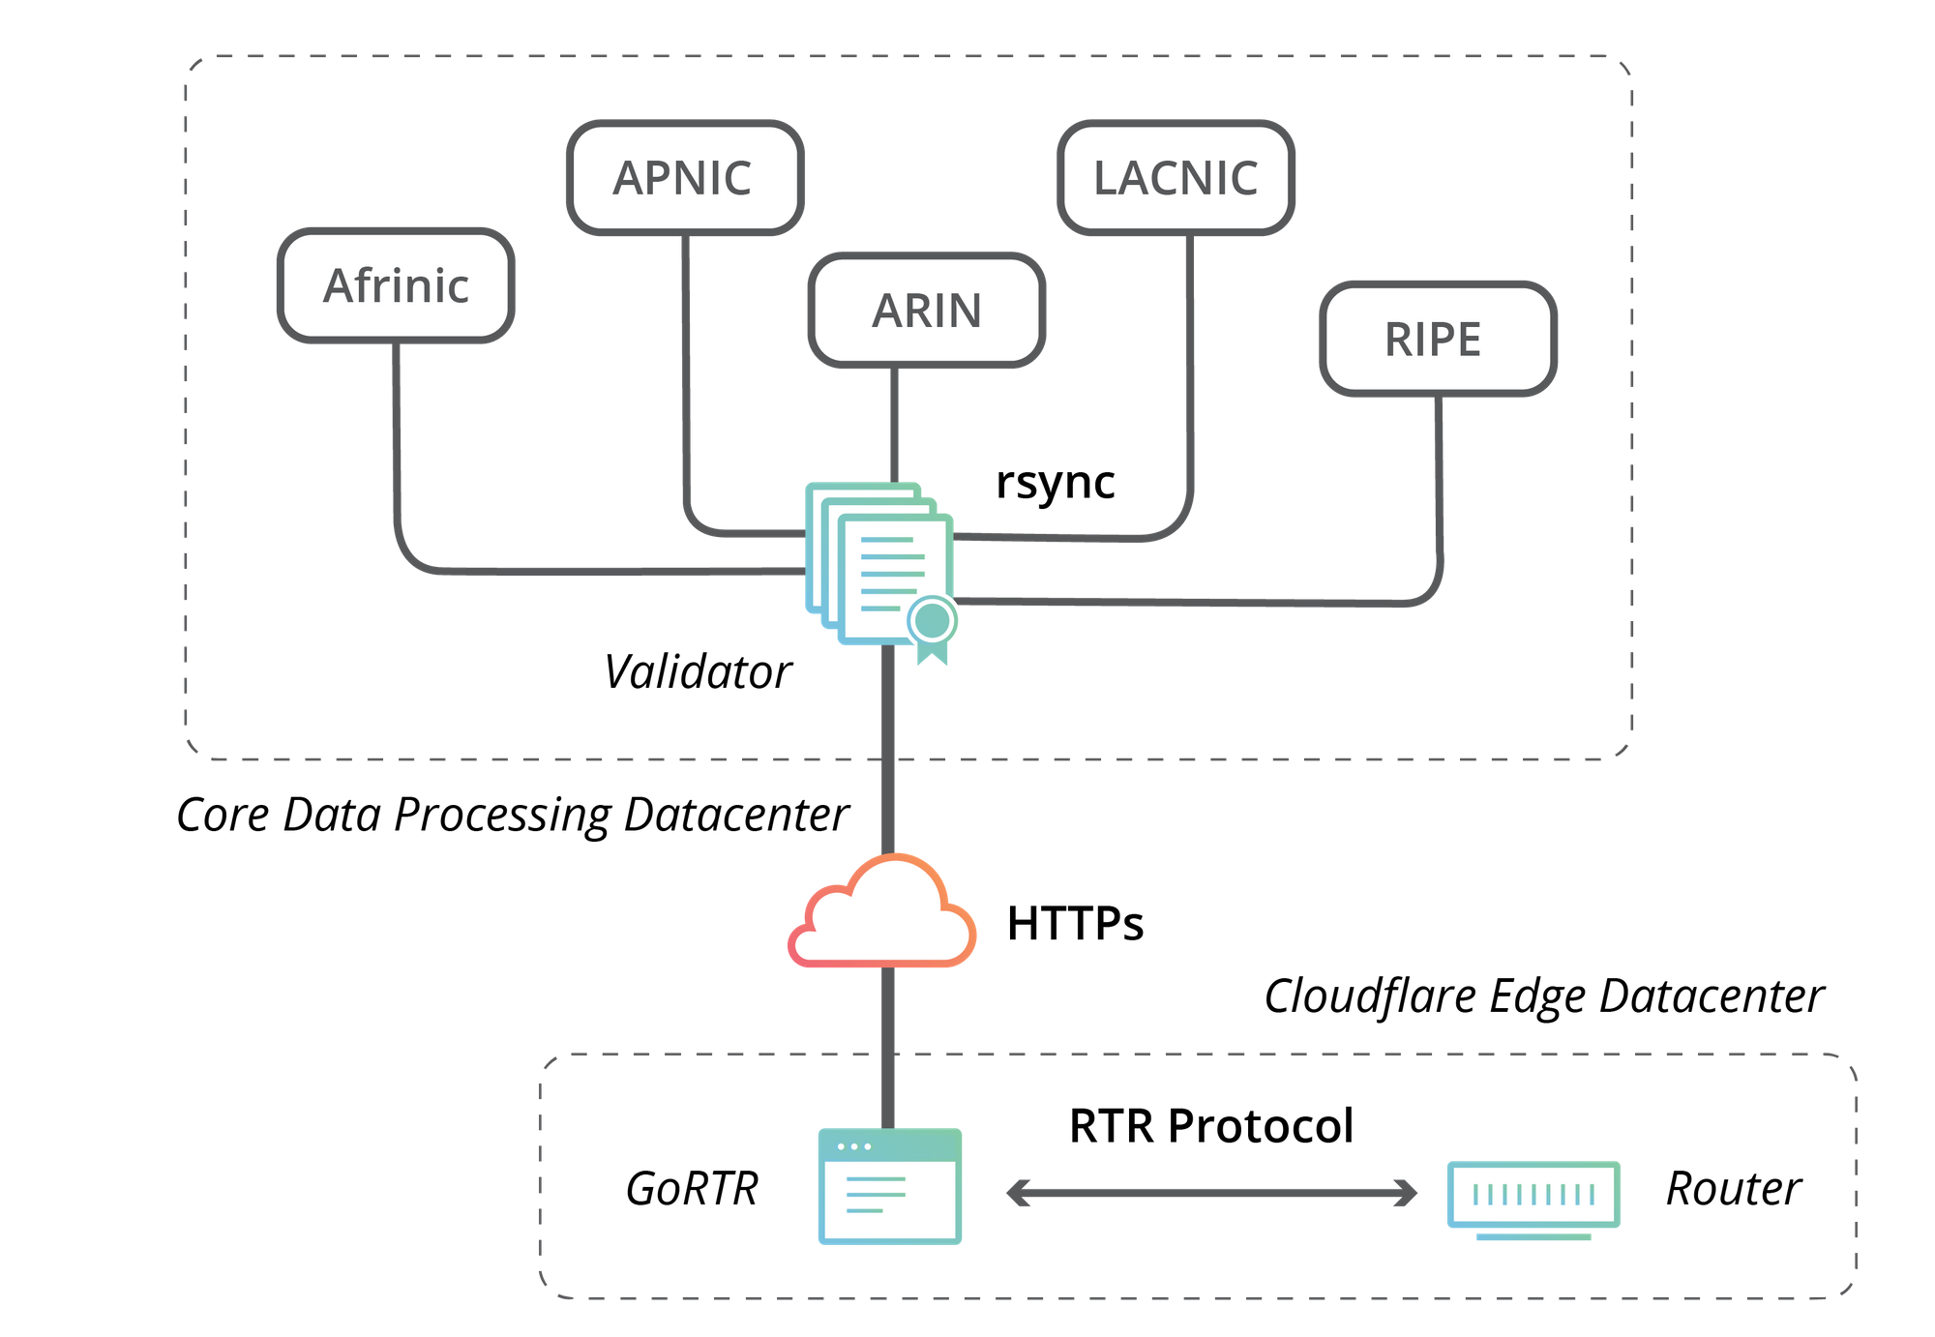
BGPSEC: Trusting the Route
Validates routing paths.
Reduces route hijacking attacks.
Protects integrity of traffic flow.
Does not encrypt the data.

Slide 7
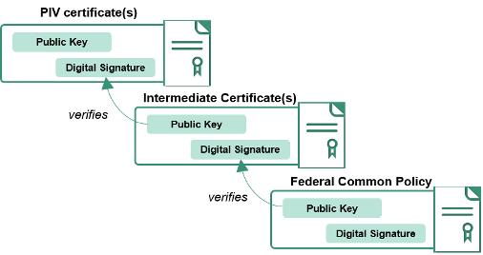
PKI: Trusting Identity
Uses certificates and signatures.
Confirms a server is who it claims to be.
Foundation of HTTPS.
Establishes identity before encryption begins.

Slide 8
Infrastructure Trust vs Message Privacy 2
DNSSEC → correct destination.
BGPSEC → correct path.
PKI → correct identity.
Encryption → protects the message itself.

Slide 9
Modern Encryption
Uses mathematical problems that are hard to solve.
Examples: RSA, Diffie-Hellman, AES.
Secure in practice under current assumptions.
Security depends on computational limits.

Slide 10
The One-Time Pad
Uses a truly random key equal in length to the message.
Key is shared securely and used once.
Provides perfect secrecy.
Ciphertext reveals no information about plaintext.

Slide 11
Layered Security in a Public World
Infrastructure mechanisms build trust.
Encryption protects content.
One-time pad shows perfect secrecy is possible.
Real systems balance theory and practicality.

Slide 12
By the End of Class
Explain how DNSSEC, BGPSEC, and PKI build trust.
Distinguish infrastructure security from confidentiality.
Describe how encryption enables privacy.
Evaluate tradeoffs between perfect and practical security.

Slide 13
Outcome
Three fundamental ideas
Randomness matters.
Key management matters more than algorithms.
Security proofs require mathematical rigor.

Slide 14
One Time Pad and Hash Functions
One-Time Pad
Security objective
Properties
Method
Proof of “perfect secrecy”
Hash Functions
Security objective
Properties
Method
Ideal security

Slide 15
One Time Pad and Hash Functions 2
One-Time Pad
Security objective
Properties
Method
Proof of “perfect secrecy”
Hash Functions
Security objective
Properties
Method
Ideal security

Slide 16



One-Time Pad
Goal: Alice secretly send Bob a message
Confidentiality (secrecy) in the presence of a passive eavesdropper (aka “Trudy”).

Slide 17
Mechanism: Encryption
Requires setup (“key distribution”):
Alice and Bob must have earlier created and
shared a random secret key (the “pad”).
Remember symmetric key?
Only Alice and Bob know the key .

Slide 18
Mechanism: Encryption 2
Alice encrypts C using key K(B) , to obtain ciphertext
Using , Bob decrypts K(B) to obtain C
Trudy cannot decipher C

Slide 19

Information-theoretically Secure vs Computationally Secure
Unconditionally secure = information-theoretically secure (assume unlimited computational power)
Compare to computationally secure (assume limited computational power (e.g. can’t factor large numbers))

Slide 20
One-Time Pad (OTP) [Gilbert Vernam 1917]
“Perfectly secure” (Information-theoretically secure, as opposed to computationally secure)
Long keys: Message and key must have same length L.
Single use: Pad is used only once.

Slide 21
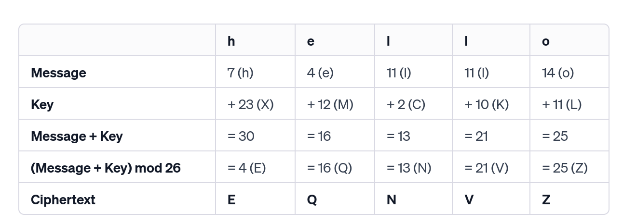
OTP Example - Encryption
wikipedia

Slide 22
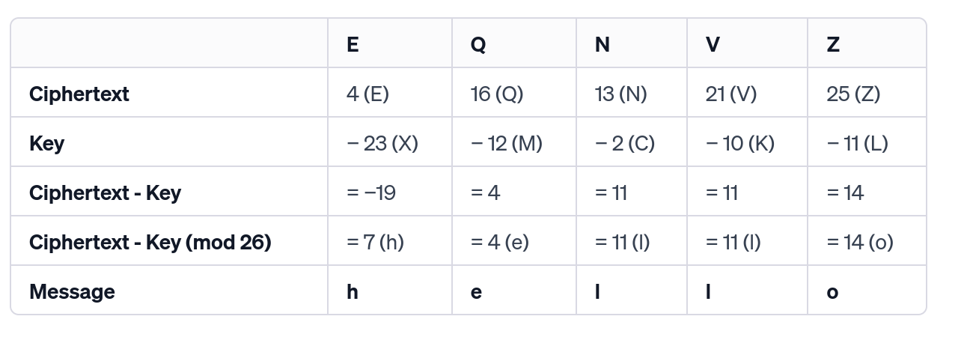
OTP Example - Decryption
wikipedia

Slide 23
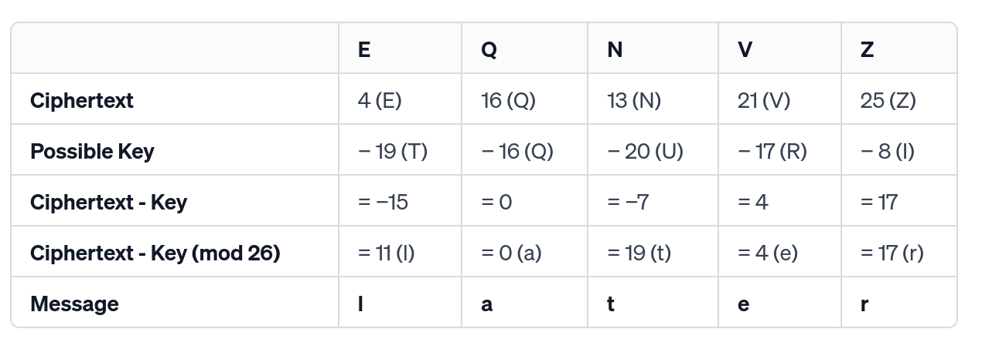
OTP Example - Why is it secure?
Yes, you can do an exhaustive search. But how do you know which message is correct?
wikipedia

Slide 24
One-Time Pad (OTP) 2/2 [Gilbert Vernam 1917]
“Perfectly secure” (Information-theoretically secure, as opposed to computationally secure)
Long keys: Message and key must have same length L.
Single use: Pad is used only once.

Slide 25
Defining Security
Unconditionally secure:
Eve cannot learn anything about msg
OTP does not hide length of message!

Slide 26
A perfect system
A cryptosystem has perfect secrecy if, for every plaintext message m∈M and every ciphertext c∈C, the probability of m being the message is equal to the probability of m being the message given that c is the ciphertext. Formally, this is expressed as: P(M=m)=P(M=m∣C=c)

Slide 27
Two-time pad - Oops
Plaintext Messages:
M1​: "HELLO"
M2​: "WORLD"
Key (used for both messages):
K: "SECRET"
Binary - >
M1​ = "HELLO" → 1001000 1000101 1001100 1001100 1001111
M2​ = "WORLD" → 1010111 1001111 1001100 1000100 1000100
K = "SECRET" → 1001111 1000101 1000011 1000101 1000100 Encryption
C1​=M1​⊕K
C2=M2⊕K

Slide 28
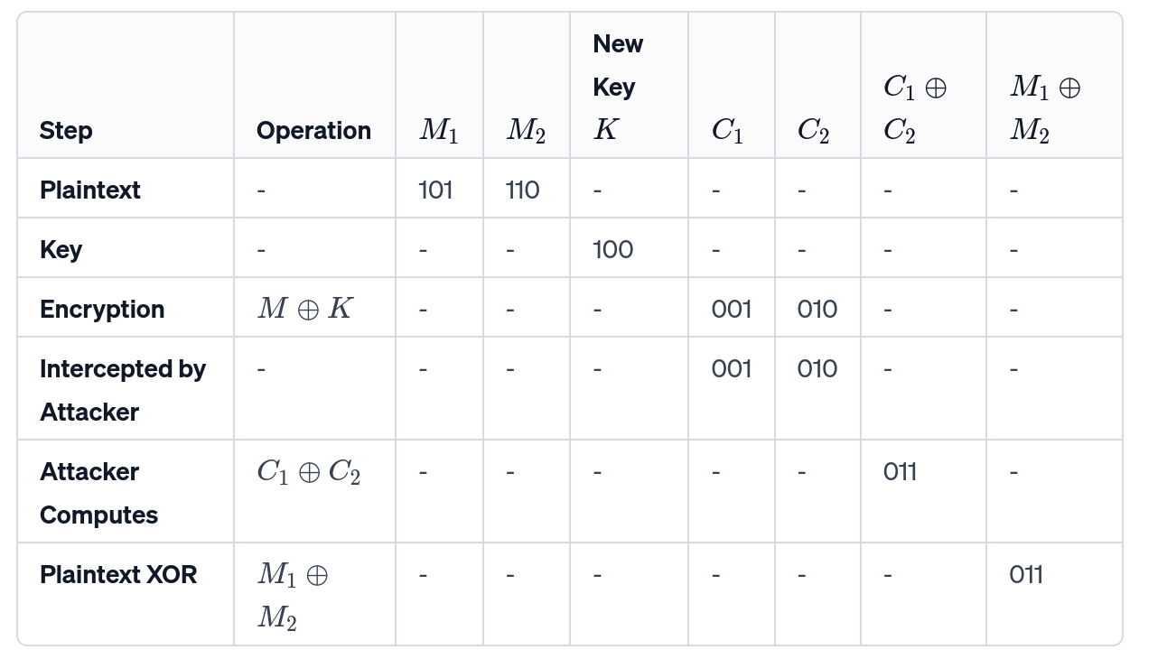
Two-time pad - Oops
C1​=M1​⊕K
C2=M2⊕K
Intercept C1 and C2 and calculate XOR.
This is equal to M1 ⊕ M2.
Then you can do freq. analysis.

Slide 29
OTP is malleable
If eavesdropper is active, then she can change corresponding message bits.
OTP provides perfect confidentiality, but not authentication or protection again message modification.

Slide 30
Hash Functions
Any function that can be used to map data of arbitrary size to fixed-size values
Input - is called the seed, and is public.
Output is called the hash value (or message digest)

Slide 31
Ideal Hash Function:
Truly random function
This (idealized, theoretical model) is called the Random Oracle Model (ROM)
Many cryptographic primitives use hash functions, and often security is proved in the ROM.
Truly
Random
unless previously queried, in which case consistent with previous answer
x
Notes:
The ROM is a theoretical model that is not achievable in practice.
It models the hash function as an oracle (i.e., black box) that on any input outputs a truly random value in denoted by unless the query was already sent, in which case the oracle replies consistently. (The oracle stores all its queries.)

Slide 32
Ideal Hash Function:
In practice, use SHA256
Truly
Random
unless previously queried, in which case consistent with previous answer
x
Notes:
SHA 256 is NOT a random oracle, but hopefully it is “pseudo-random enough” that an adversary cannot exploit any flaws in it.

Slide 33
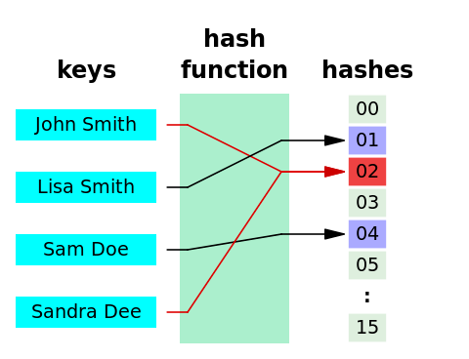
Desired Properties
One-Way
Collision Resistant

Slide 34
Desired Properties
Target Collision Resistant
Pseudo-randomness Non-Malleability

Slide 35
Applications
Password storage (for login)
When user logs in, check consistency of password with the hash value
Security property:
Given the hash can’t find the password
File modification detector
Security property:
Can tell if a file has been modified.
3. Digital signatures
Instead of signing msg sign the hash

Slide 36
The Other one – Random Numbers
Radioactive sources
Microphone, camera
atmospheric noise
https://www.cloudflare.com/learning/ssl/lava-lamp-encryption

Slide 37
Reading
Kaufman: https://www.nist.gov/publications/network-security-private-communication-public-world-3rd-edition
Chapter: 2.1, 2.4, 2.6 We will talk about random numbers next.

